Slide 1
Running a C program
& A basic intro to makefile

Slide 2
Couple of things to keep in mind
You should have you C/C++ compilers installed on your computer.
Consider setting up WSL on VS Code if you haven’t already installed a linux distribution (virtual/ maybe not).
You can follow any sort of youtube tutorials to have these set up. Pretty easy stuff.

Slide 3
Compilation and Execution of Code in C
The first thing you do when running any piece of code in any language is Compiling said code. Compilation of a code is checking for syntax errors, type checking, semantic analysis etc, i.e, checking whether the code is written properly or not and then generating an executable file.
The executable file is a translation of human readable code into machine readable binary form. Whenever you’re running any piece of code, the computer can only run the generated executable.
Moving on to actual implementation.

Slide 4
Running a C program
Normally, when you’re done writing a program, you simply click on some sort of a run button and everything else happens on its own. Here, when you’re working on shell and kernel computing, you won’t be writing codes on IDEs but on simple text editors which will not give you this luxury.
Assuming you have your program written and you have installed a C/C++ compiler on your computer, you navigate to the folder containing your program on the terminal and write the following.
gcc program_name.c -o executable_name
Be careful of your path variables, if you want to use a file in some other folder you’ll have to call it by its complete or relative path and the executable is formed in the same folder.

Slide 5
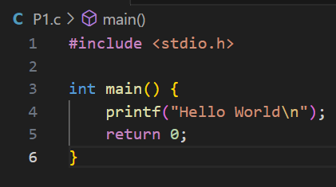
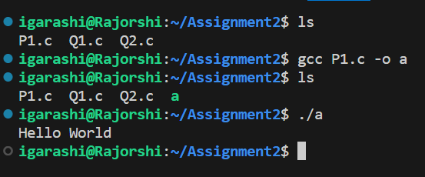
Compiling and Execution
An Example
An Example

Slide 6
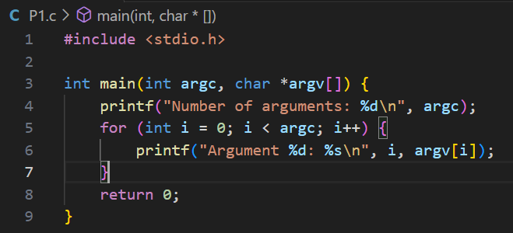
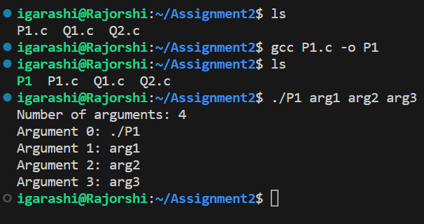
Another One
Passing arguments on to the executable

Slide 7
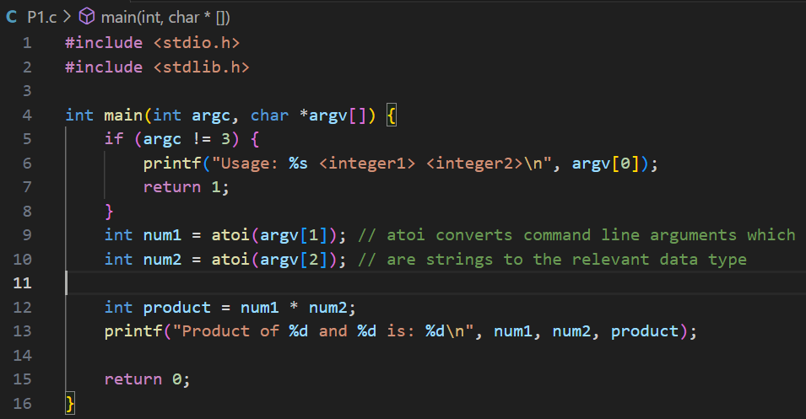
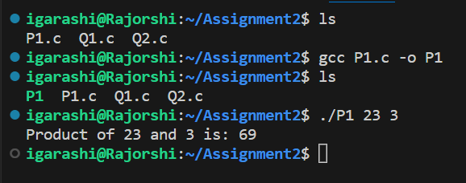
Another One
Passing arguments on to the executable

Slide 8
What is a Makefile
When you’ll be working on assignments and projects you will be creating multiple programs at once that may be working in tandem with each other.
In your case, you’d probably create a 5-10 programs at a time but for bigger projects like the linux kernel itself, there are at least a thousand files for specific tasks or objectives.
In such a case you won’t be going around compiling each and every program individually and would want to find some sort of a solution that does this in one step.
That is where the makefile comes in.

Slide 9
What is a Makefile
A Makefile is a simple text file used in software development to automate the process of compiling and building a program or project. It contains a set of rules and instructions that specify how source code files should be compiled, linked, and transformed into executable programs or libraries. Makefiles are commonly used in Unix-like operating systems to manage complex build processes and dependencies, making it easier for developers to maintain and update their projects.
In a crude sense, you write all of your compilation commands in one file and run it every time you make edits in however many files in your project. It only re-compiles the newly edited ones.

Slide 10
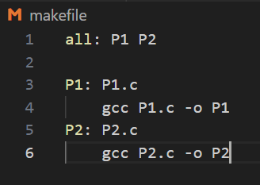
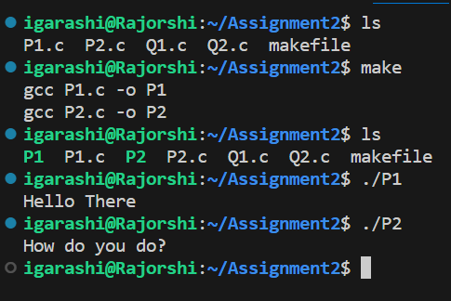
Example of a Makefile
This is a simple implementation.
The top contains all executables to be produced.
The way you read it is:
  Target(P1): Dependable(P1.c can be omitted)
Compilation command (gcc P1.c -o P1)
The makefile constructed from bottom up
That is if P1 depends on P2 then the
command to compile P2 is below, after
P1’s command. Example afterwards

Slide 11
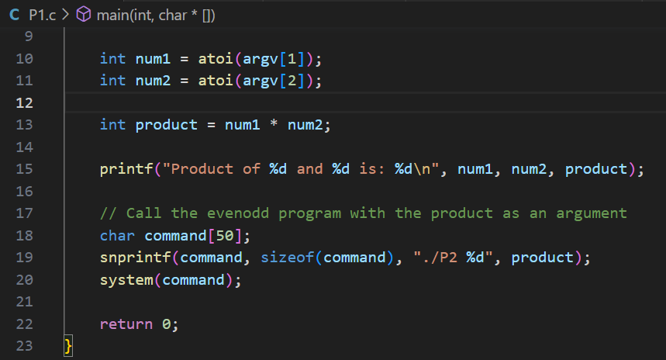
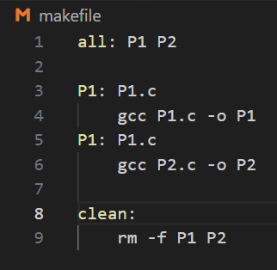
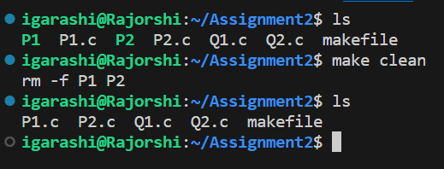
Another One
This is just a primitive example to show how dependency between two programs exist.
P1 calls the executable of P2 (P2 determines if the product is even or odd, context not too important to know).
In this case switching compilation order of the two executables won’t result in an error.
Also, introducing clean clause in the makefile allows you to remove any previously generated executables.

Slide 12
Shell Commands
in Linux

Slide 13
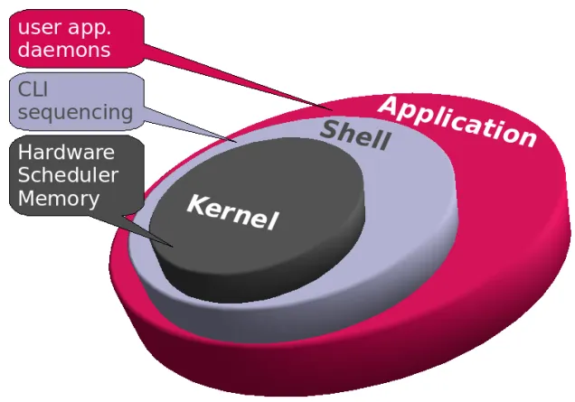
A Basic Introduction
User program that provides an interface to use OS services.
Accepts human-readable commands and converts them into something which the kernel can understand.
Kernel acts as a bridge between applications and data processing performed at hardware level using inter-process communication and system calls
Shell can have a GUI or CLI
Shell types - Bash, CSH, KSH

Slide 14
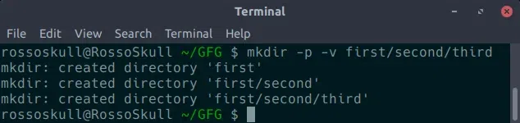
Shell Commands
In Linux, commands are ways or instructions through which you can instruct your system to do some action. Commands are executed in the command line.
Syntax:
command [option] [argument]
Eg. 1. rm -rf (Just try this 🙂)
2. pwd
3. mkdir first/second/third

Slide 15
Internal(Built-in) Shell Commands
Built-in commands are internal commands that are built-in the shell. Built-in commands are called from the shell and executed directly within the shell itself.
For all the shell built-in commands, execution of the same is fast in the sense that the shell doesn’t have to search the given path for them in the PATH variable, and also no process needs to be spawned for executing it.
It checks whether the typed command is an internal command. If is an internal command, it executes it from the memory. When you start a Linux shell, the shell copies all internal commands to RAM and executes them from there.
Getting the list of Internal Commands: $help

Slide 16
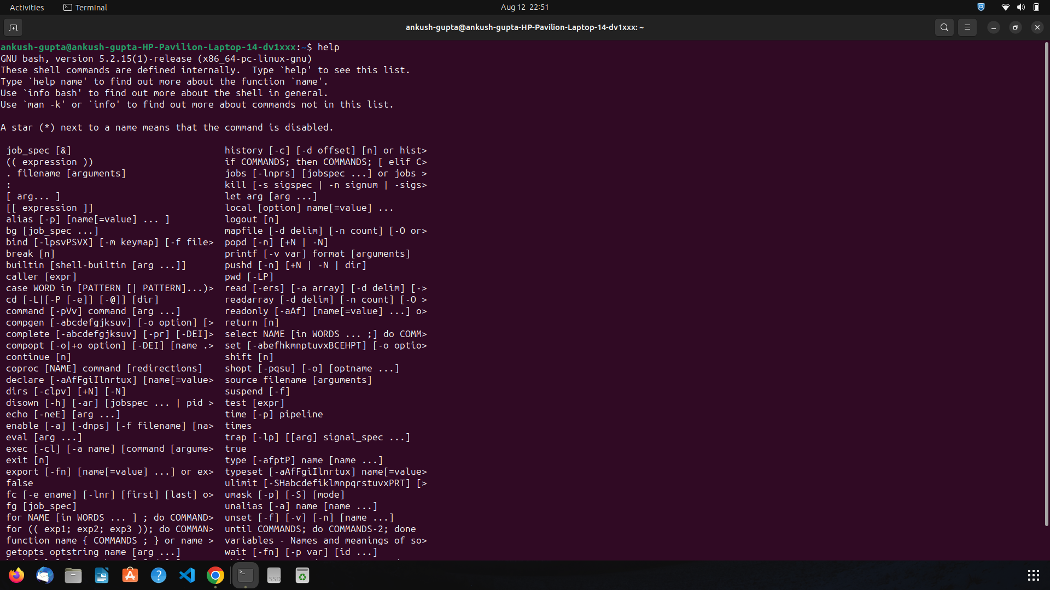

Slide 17
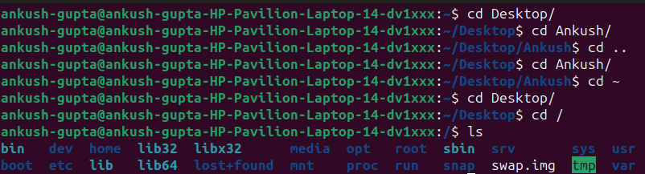
cd (change directory)
cd-gfg cd-manpage chdir-manpage chdir-gfg
cd [directory]
By using / as an argument in cd we can change the directory to the root directory.
~ this argument is used in cd command to change the directory to the home directory from any location in Linux System.
We use .. this as an argument in cd command which is used to move to the parent directory of current directory, or the directory one level up from the current directory.
cd "dir name"
Executing this in your CSH
chdir("Directory");
char add[100];
getcwd(add,100);
printf("%A1>>>%s\n",add);

Slide 18
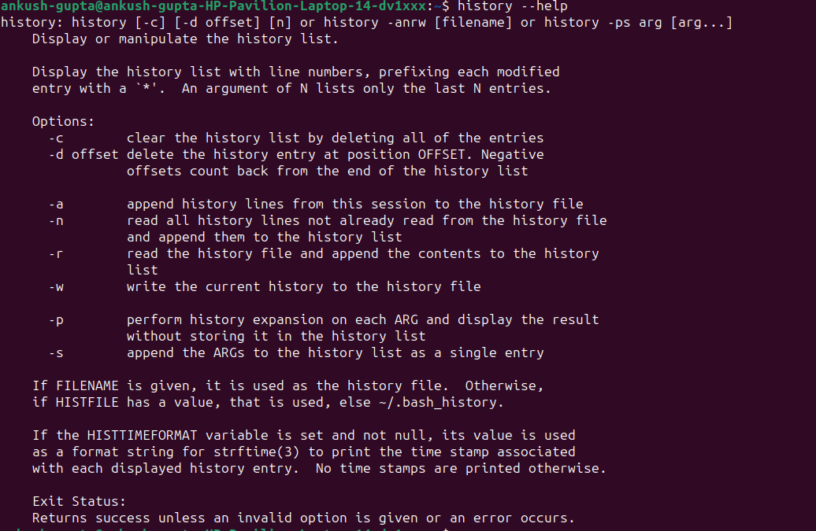
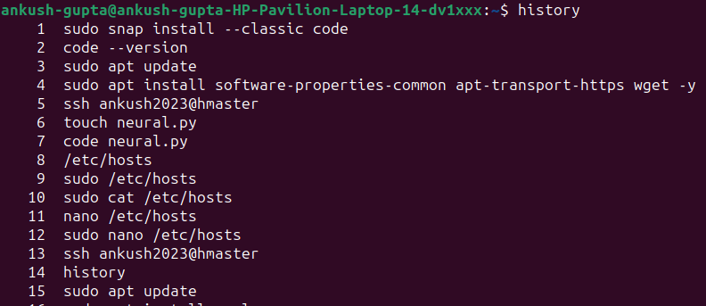
2. history
history-gfg history-manpage
To show the limited number of commands that executed previously
history | grep chpasswd
!! – just recent
Executing this in your CSH
Maintain an array
As simple as that

Slide 19

3. read
read-gfg read-manpage
read command in Linux system is used to read from a file descriptor. Basically, this command read up the total number of bytes from the specified file descriptor into the buffer.
If we pass the read command without any argument, it will take a line as user input and store it in a built-in variable 'REPLY'. Execute the command as:
read -p, read -n, read -s
Executing this in your CSH
Basically input output use scanf, printf

Slide 20
External Shell Commands
External commands are other than built-in commands. These commands are programs which have their own binary and located in the filesystem. These are the commands that your system offer and are totally shell independent.
When an external command has to be executed, the shell looks for its path given in the PATH variable, and also a new process has to be spawned and the command gets executed.
It checks whether the typed command is an external command. To know whether the typed command is an external command, it uses the PATH variable. The PATH variable contains the location of the directories having external commands' files. The shell checks all directories specified in the PATH variable. If it finds a file matching the typed command in any directory, it copies the file into RAM and executes it from there. If the user executes the same command again, it executes it from RAM. If the shell does not find a file related to the typed command in any directory, it returns the 'command not found' error.

Slide 21
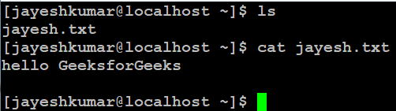
1.cat (concatenate)
cat-gfg cat-manpage
It reads data from the file and gives its content as output. It helps us to create, view, and concatenate files.
cat file_name1 __ __
cat -n, cat >, cat -E, cat -A, …
Executing this in your CSH
Note: Its code will not be in the same file as of shell script, it will be executed using exec command as taught earlier in the tut.
In the code u can use fopen (for opening file), fgetc (reading characters), printf
H.W. Try this code

Slide 22
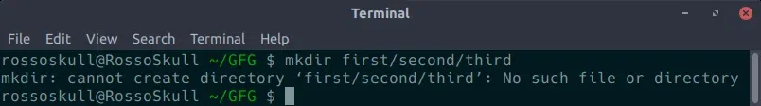
2.mkdir (make directory)
mkdir-gfg mkdir-manpage mkdir(c lib)-manpage opendir(c lib)-manpage
allows the user to create directories (also referred to as folders in some operating systems). This command can create multiple directories at once as well as set the permissions for the directories.
mkdir --help, mkdir --version, mkdir -v [directories], mkdir -p [directories],
Executing this in your CSH
Note: Its code will not be in the same file as of shell script, it will be executed using exec command as taught earlier in the tut.
In the code u can use opendir(filename) && mkdir((filename), mode_t)
H.W. Try this code

Slide 23
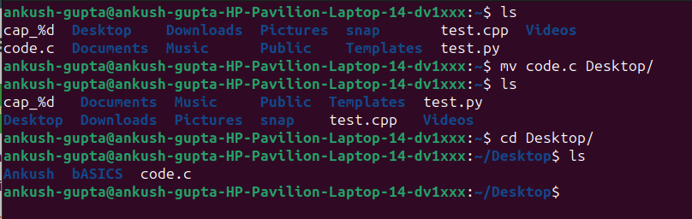
3.mv (move)
mv-gfg mv-manpage
The mv command moves files and directories from one directory to another or renames a file or directory. If you move a file or directory to a new directory, it retains the base file name. When you move a file, all links to other files remain intact, except when you move it to a different file system. When you move a directory into an existing directory, the directory and its contents are added under the existing directory.
mv -d, mv - e, mv -n, mv - v
Executing this in your CSH
int main(int argc, char **argv){
int fd1,fd2;
int n,count=0;
fd1=open(argv[1],O_RDONLY);
fd2=creat(argv[2],S_IWUSR);
rename(fd1,fd2);
unlink(argv[1]);
return (0);
}

Slide 24
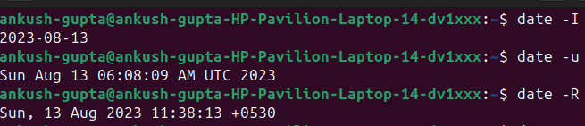
4.date
date-gfg date-manpage
The date command displays or sets the date and time.
The following formats can be used when setting the date with the Date parameter:
  mmddHHMM[YYyy] (default)
  mmddHHMM[yy]
date -u, date -s, date -R
Executing this in your CSH
Note: Its code will not be in the same file as of shell script, it will be executed using exec command as taught earlier in the tut.
In the code u can use getdate() & setdate()
H.W. Try this code

Slide 25
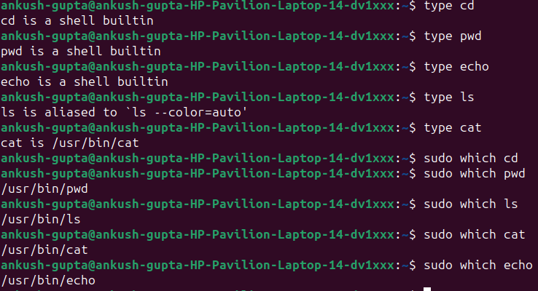
Knowing the type of a command
To know whether a command is an internal command or an external command, you can use the type and which commands. The which command displays the location from where the shell executes the command. The type command displays the type of the command.
Use the which command to print the location from where the shell executes
use the type command to display the type of the same commands

Slide 26
Questions

